Slide 1
K Means
CUNY LaGuardia Community College

Slide 2
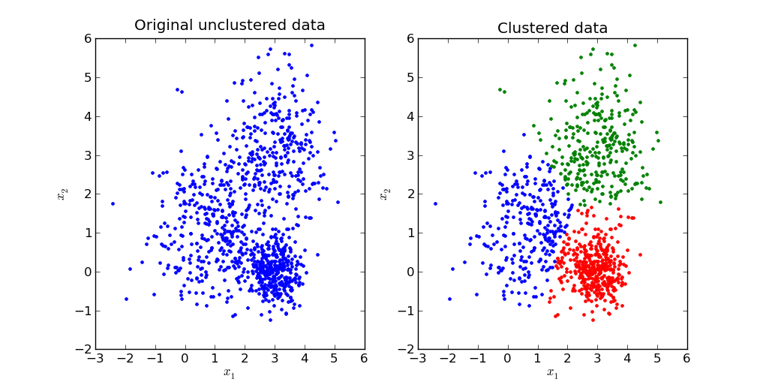
What is K Means?
K-Means is an unsupervised clustering algorithm that groups data points into K distinct clusters based on their features. Unlike the classification algorithms covered before, K-Means doesn’t use labels or classes; instead, it finds natural groupings within the data based on similar characteristics.

Slide 3
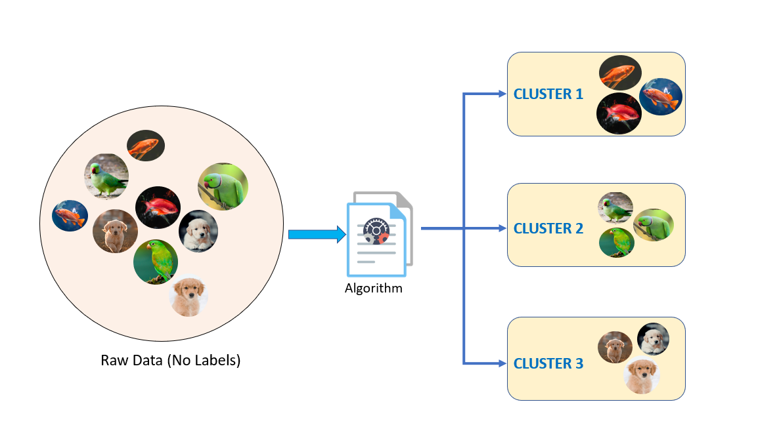
Unsupervised Learning
Unsupervised learning algorithms organize data into groups without needing any labels. It looks for patterns and similarities within the data.
For instance, in a pet shop, an unsupervised learning model like K-Means would look at features like feathers, fur, scales, legs or fins, and group the pets with similar features. These groups are called clusters.

Slide 4
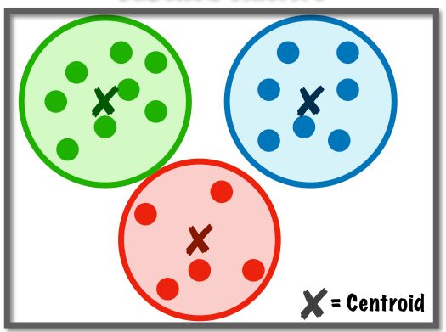
Centroids
A centroid in K-Means is a point that represents the center of a cluster. Initially, centroids are placed randomly. Then, with each iteration, they are moved to the average (mean) position of all points assigned to them. This process continues until the centroids stabilize at the center of their clusters, effectively capturing the main characteristics of each group.

Slide 5
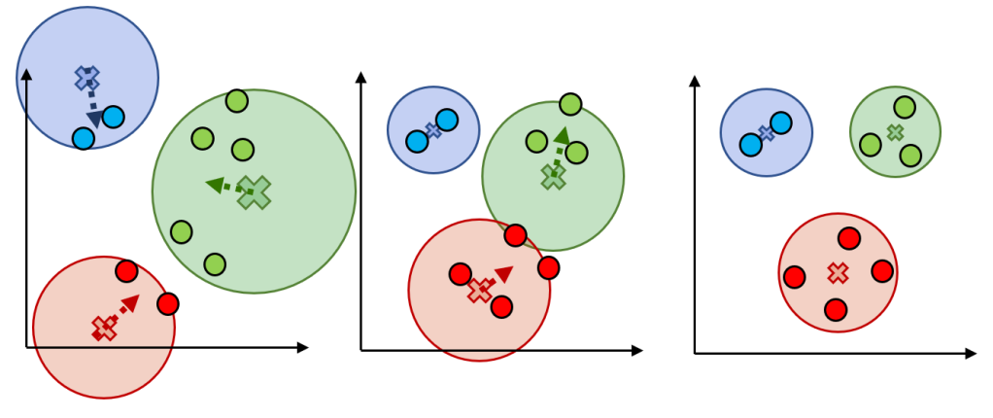
How Centroids find the Center

Slide 6
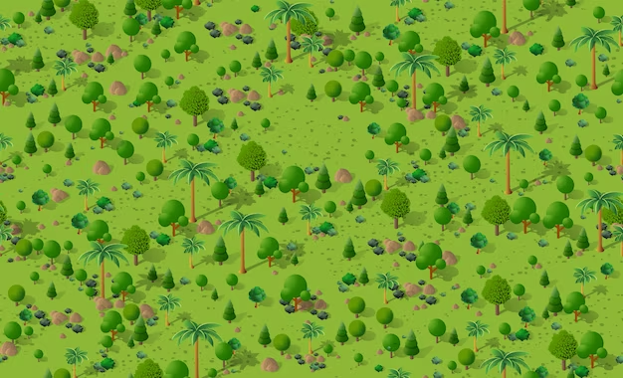

The Centroid Process
Imagine you and your siblings inherit a large forest, and you need to divide it into territories. You each plant a flag at a random spot in the forest to mark your starting area, and then begin a process of claiming trees.

Slide 7
The Centroid Process - Initial Positioning
Each tree in the forest is claimed by the sibling whose flag is closest, forming three initial territories around the flags. No trees move; they’re simply assigned to the nearest flag.

Slide 8
The Centroid Process - Repositioning Centroids
To make each territory fairer, each sibling moves their flag to the center of their claimed trees. This ensures each flag is more centrally located within its territory.

Slide 9
The Centroid Process - Reallocating Clusters
To make each territory fairer, each sibling moves their flag to the center of their claimed trees. This ensures each flag is more centrally located within its territory.

Slide 10



The Centroid Process - Finish when Stable
You keep adjusting the flag positions and re-claiming trees until the territories stabilize. At this point, each flag is at the center of its territory, and every tree is claimed by its closest sibling’s flag.

Slide 11
The Centroid Process - Recap
In this analogy, trees (data points) never move; they’re simply claimed by the closest flag (centroid). Through iterative re-positioning, each sibling finds the most central spot for their flag, resulting in stable territories that reflect the forest’s natural divisions. These territories are clusters, and often reveal meaningful grouping within the dataset, that can then go on to be labeled and used to extract insights and make predictions

Slide 12
The Centroid Process - Exceptions Part 1
K = 1 (Single Cluster)
With K = 1, there’s only one cluster, so the centroid just moves to the overall average of all points. This happens in two steps and doesn’t actually separate data into multiple groups.
Poor Initial Placement of Centroids
If centroids start in bad positions (e.g., too close together), K-Means may find incorrect or inefficient clusters. Running K-Means multiple times from different starting points can improve results.
Choosing the Wrong Number of Clusters (K)
Setting K too low merges distinct groups, while too high splits groups unnecessarily. Use methods like the Elbow Method to help find a better K.

Slide 13
The Centroid Process - Exceptions Part 2
Empty Clusters
Sometimes, a centroid ends up with no points assigned to it, leaving an “empty cluster.” Reinitialize the empty centroid to a new location to fix this.
Non-Spherical or Irregular Clusters
K-Means expects spherical clusters, so it struggles with elongated or irregular shapes. For complex shapes, consider other methods like DBSCAN.
Overlapping Clusters
When clusters overlap, boundary points may keep switching clusters, causing instability. Increasing K or using soft clustering can create clearer clusters in overlapping areas.

Slide 14
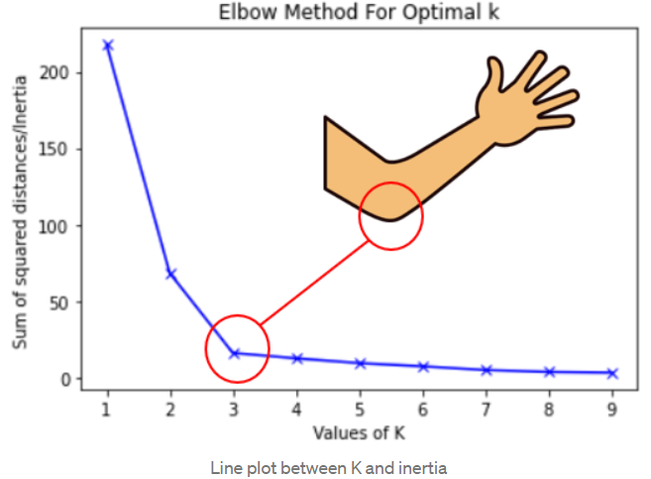
Choosing K - The Elbow Method

Slide 15
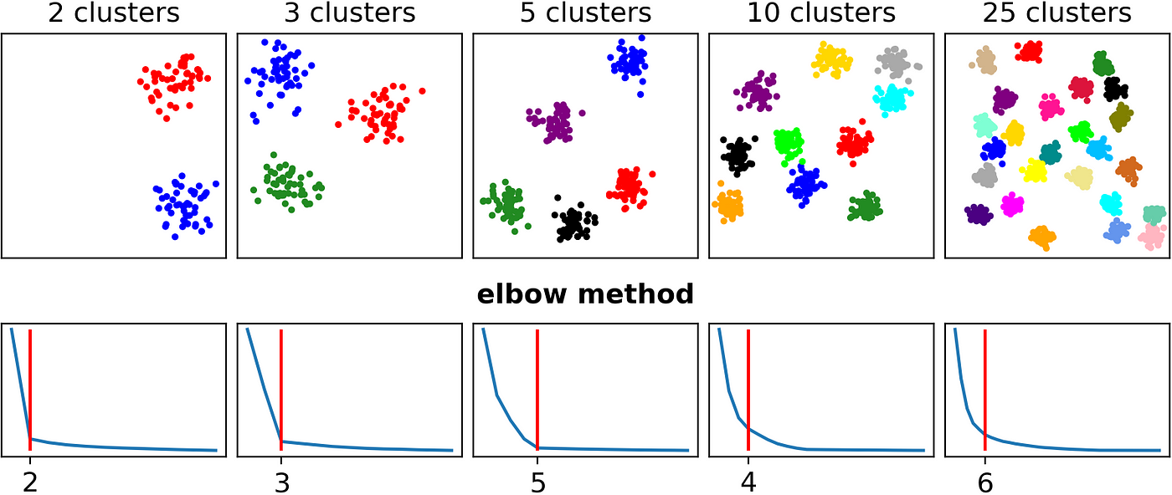
Choosing K - The Elbow Method
The Elbow Method shows where adding more clusters stops improving cluster quality significantly, helping to avoid overfitting with unnecessary clusters

Slide 16
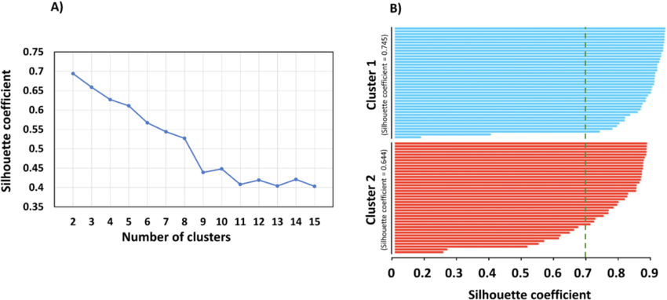
Choosing K - The Silhouette Method

Slide 17
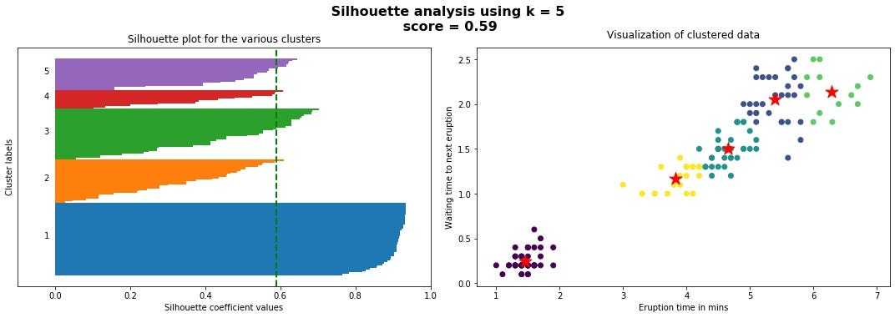
Choosing K - The Silhouette Method
The Silhouette Method evaluates how well data points fit within their assigned clusters by measuring both internal cohesion and external separation between clusters

Slide 18
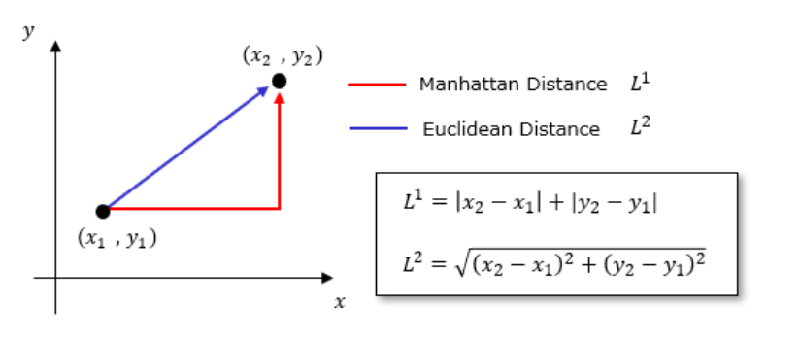
Distance

Slide 19
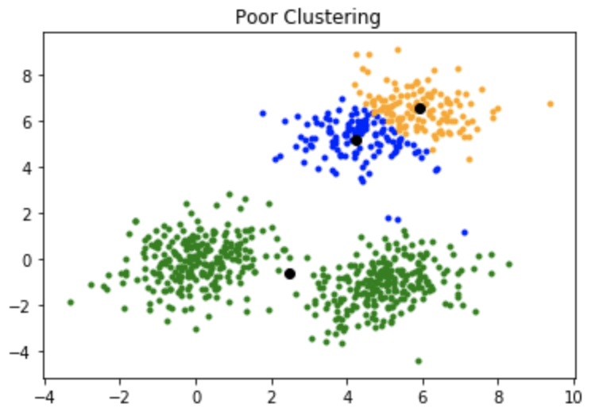
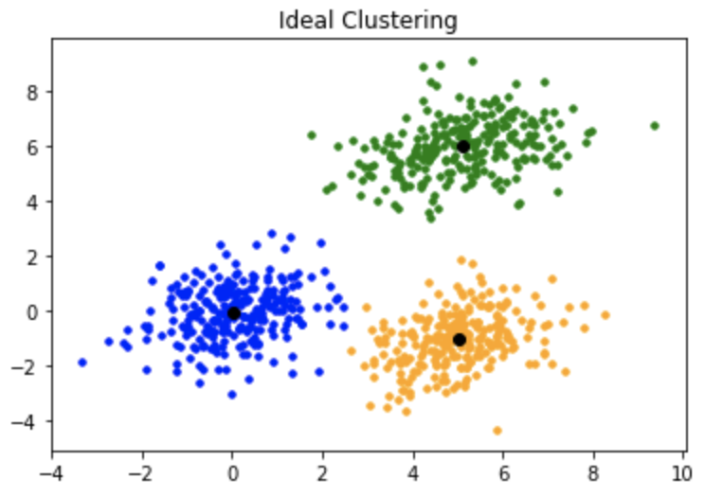
Initialization Methods

Slide 20
Initialization Methods - K Means++
Add data points to cluster
Assign all points closest to this new centroid to its cluster.
Calculate Distances for Remaining Points
For each remaining data point, calculate its distance to the nearest centroid chosen so far.
Choose the first centroid randomly
Select Next Centroid Based on Probability
Select the next centroid with a probability proportional to the square of the distance to the nearest existing centroid. This means points that are farther from any centroid have a higher chance of being selected.

Slide 21
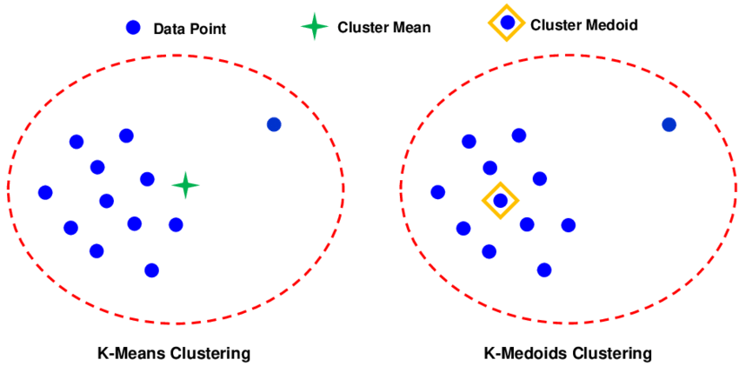
Initialization Methods - K Medoids

Slide 22
Initialization Methods - K Medoids Maximin
Add data points to cluster
Assign all points closest to this new medoid to its cluster.
Calculate Distances for Remaining Points
For each remaining data point, calculate its distance to the nearest medoid chosen so far.
Choose the first medoid randomly
Select Next Centroid Based on Maximum Distance
Select the data point with the greatest distance from all other existing medoids. This means points that are farther from any medoid have a higher chance of being selected.

Slide 23
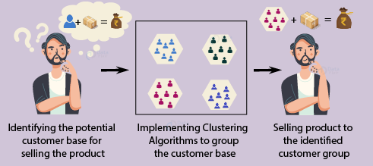
K-Means in the Real World

Slide 24
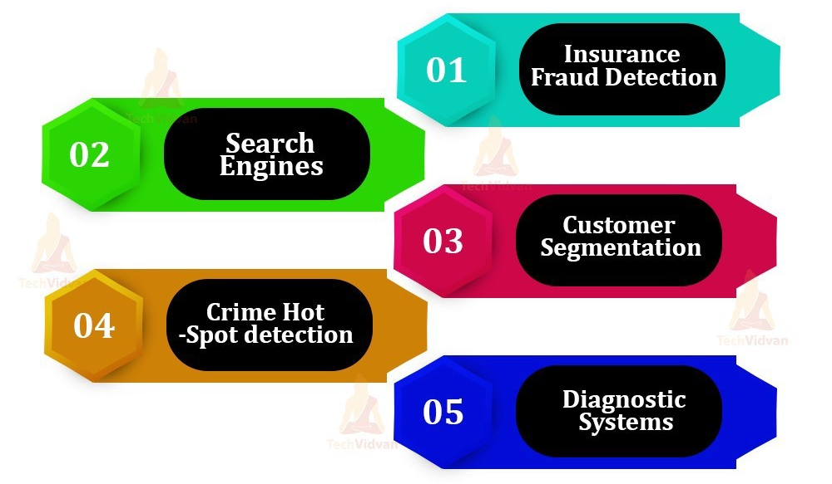
Applications of K-Means
How does K-Means help in these specific use cases? What are some other ways that K-Means could be used to generate insights or predictions from unlabeled data?

Slide 25
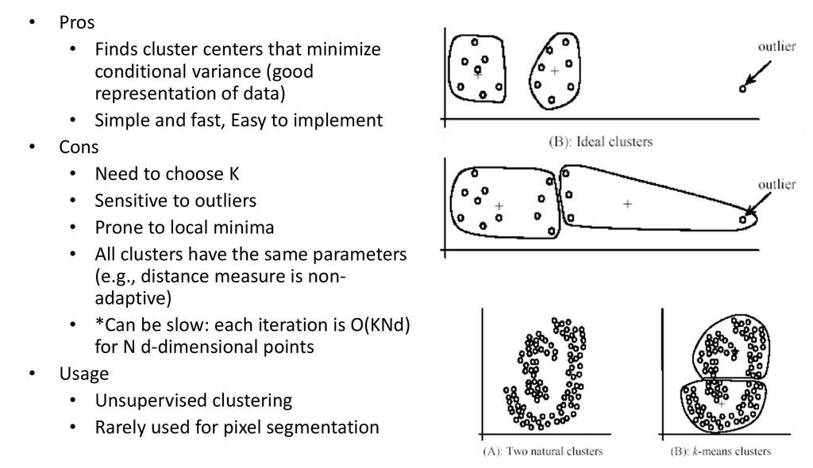
Advantages and Disadvantages

